Slide 1
Data Quality and Database Management & Preparation for Assessment 3
Week 11
Dr. Farshid Keivanian

Slide 2
Week 11: Outline
Purpose
Part A: Data Quality Investigation
Part B: Database Security Case Study
Part B – Independent Work on Assessment 3

Slide 3
Purpose
This tutorial helps you understand:
how to identify poor-quality data
how to match data problems to data quality dimensions
how database security problems affect organisations
how these ideas support Assessment Task 3

Slide 4
Part A: Data Quality Investigation
Step 1: Read the student table carefully
Look at each column:
StudentID
Name
Email
Phone
Course
Last Updated
Check whether the data looks correct, complete, valid, current, and not repeated.

Slide 5
Part A: Data Quality Investigation
Step 2: Identify dirty data
Dirty data means data that has mistakes or problems. Look for:
missing values
wrong formats
duplicate records
outdated information
inconsistent details

Slide 6
Part A: Data Quality Investigation
Step 3: Match the problem to a data quality dimension
Use these meanings:
Dimension | Simple meaning
Accuracy | Data is correct
Completeness | No important data is missing
Consistency | Data follows the same format/rules
Timeliness | Data is up to date
Validity | Data follows the correct format
Uniqueness | No duplicate records

Slide 7
Part A: Data Quality Investigation
Activity A — Answers
Q1. Identify examples of dirty data
Type of issue | Example | Explanation
Inaccurate data | Phone number 123 for Ahmed Khan | This is not a realistic phone number
Incomplete data | Maria Chen has NULL phone | The phone number is missing
Invalid data | johnsmith@gmail | Email address is incomplete because it has no proper domain such as .com
Duplicate data | StudentID 1001 appears twice for Sarah Lee | Same student appears more than once
Outdated data | John Smith last updated 2023-01-15 | This record may be too old compared with 2025 records

Slide 8
Part A: Data Quality Investigation
Q2. Match each issue to the correct data quality dimension
Issue | Data quality dimension
Wrong phone number such as 123 | Accuracy
Missing phone number NULL | Completeness
Two different email formats for Sarah Lee | Consistency
Old record from 2023 | Timeliness
Invalid email johnsmith@gmail | Validity
Repeated StudentID 1001 | Uniqueness

Slide 9
Part A: Data Quality Investigation
Q3. Suggest one method to improve the quality of this dataset.
Students should try this themselves
A possible answer could be:
Use validation rules, such as checking email format, requiring phone numbers, preventing duplicate StudentIDs, and regularly updating old records.

Slide 10
Part B: Database Security Case Study
Step-by-step guideline
Step 1: Read the scenario
The database was breached because:
default passwords were not changed
security patches were ignored
audit logging was disabled
too many users had administrator access

Slide 11
Part B: Database Security Case Study
Step 2: Connect each problem to a security goal
The main security goals are:
confidentiality
integrity
availability
compliance
Step 3: Identify vulnerabilities
A vulnerability is a weakness that attackers can use.

Slide 12
Part B: Database Security Case Study
Activity B - Q1. Which security goals were violated?
Security goal | How it may have been affected
Confidentiality | Hackers accessed student personal information, so private data was exposed
Integrity | Hackers may have changed, deleted, or damaged student records
Availability | The system may have been disrupted or taken offline after the breach
Compliance | The university may have failed to follow privacy and data protection requirements

Slide 13
Part B: Database Security Case Study
Q2. Identify at least FOUR security vulnerabilities
Default passwords were never changed.
Security patches were ignored.
Audit logging was disabled.
Too many users had administrator access.
Other possible vulnerabilities:
weak access control
poor monitoring
lack of regular security review
poor password policy

Slide 14
Part B: Database Security Case Study
Q3. Recommend practical safeguards using ideas from the lecture on Canvas
Q3. Students should try this themselves
A good answer may include safeguards such as:
change default passwords immediately
apply security patches regularly
enable audit logging
limit administrator access
use strong passwords and multi-factor authentication
regularly back up the database
train staff on security procedures

Slide 15
Part B: Independent Assessment 3 Work
Students should use the remaining time to:
Work on database queries for Part A of Assessment 3.
Check whether their SQL queries produce the correct results.
Start preparing presentation slides or a speaking script for Part B.
Q3 in both activities is useful for students to attempt independently because it helps them practise applying the lecture ideas.

Slide 16
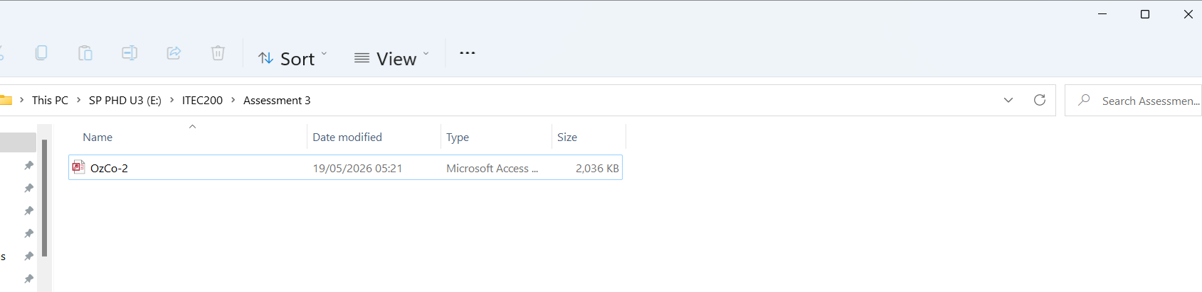
Part B – Independent Work on Assessment 3
Step 1: Open the OzCo database
Download and open the OzCo database in Microsoft Access.
Clarification: This is the database file where all tables are stored.

Slide 17
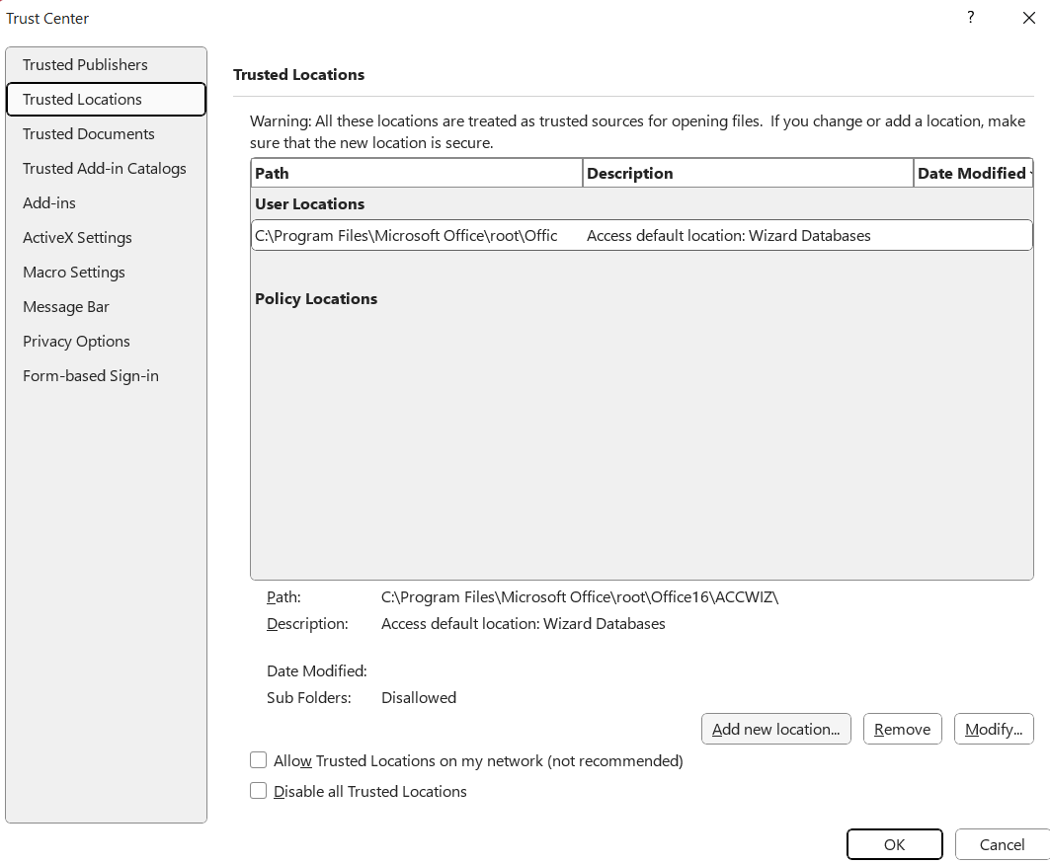
Part B – Independent Work on Assessment 3
Go to Trusted Locations → Add new location.
Add the folder where you saved OzCo-2.mdb (e.g E:\ITEC200\Assessment 3)

Slide 18
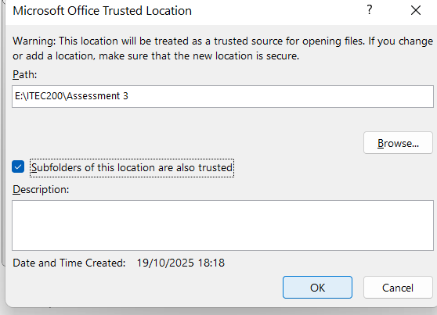
Part B – Independent Work on Assessment 3
Tick “Subfolders of this location are also trusted.” Click OK → OK → OK. This ensures any future Access databases in that folder open without warnings.

Slide 19
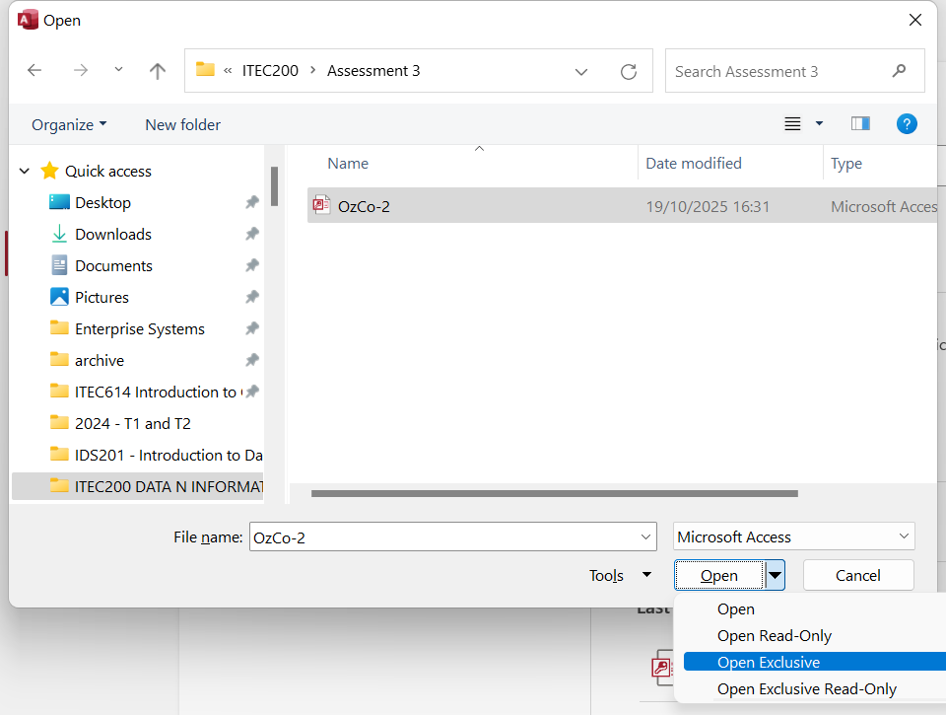
Part B – Independent Work on Assessment 3
Now open → browse → Open Exclusive

Slide 20
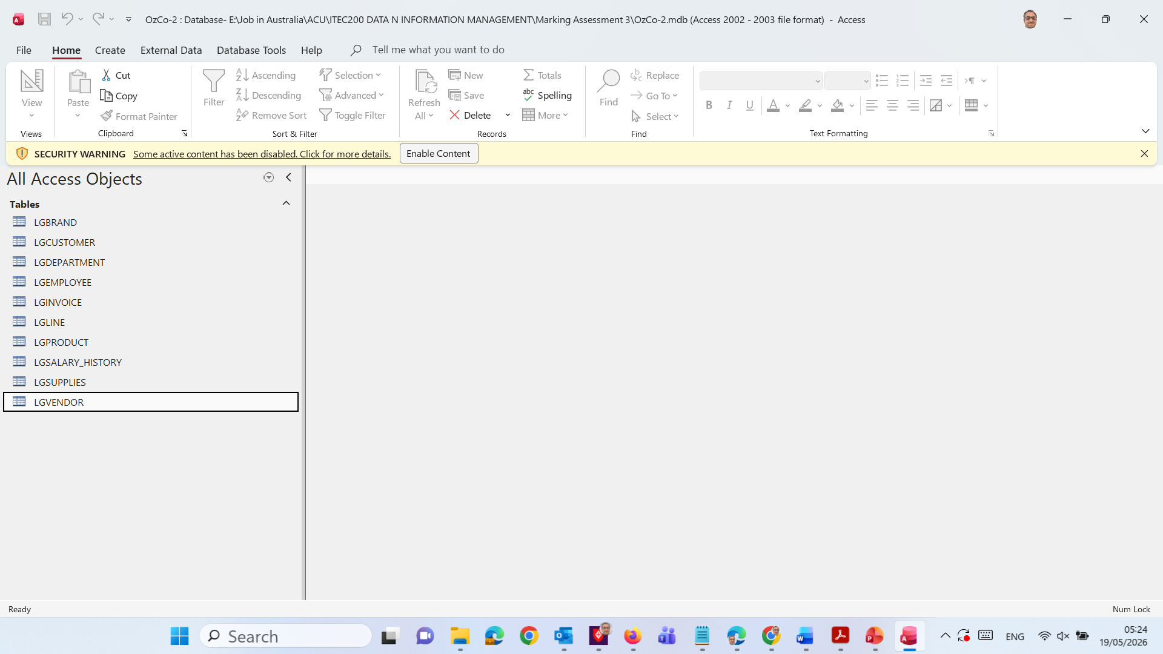
Part B – Independent Work on Assessment 3
Click Enable Content

Slide 21
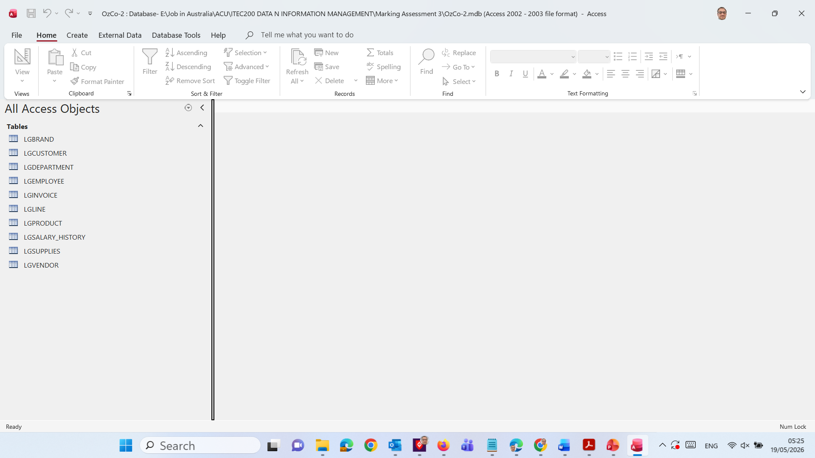
Part B – Independent Work on Assessment 3
You will see this

Slide 22
Part B – Independent Work on Assessment 3
Step 2 and 3: Set Primary Keys and Create relationships
We need to Go to Database Tools → Relationships and connect tables using matching fields.
Clarification: Relationships show how tables are linked, for example customers connect to invoices.
We need to open each table in Design View and set the correct primary key based on the ERD.
Clarification: A primary key uniquely identifies each record, such as Customer Code or Product SKU.

Slide 23
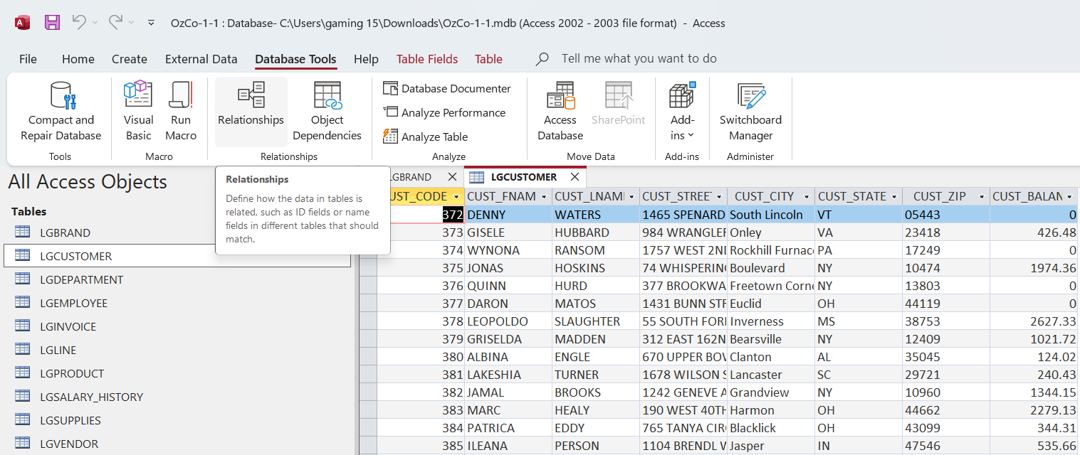
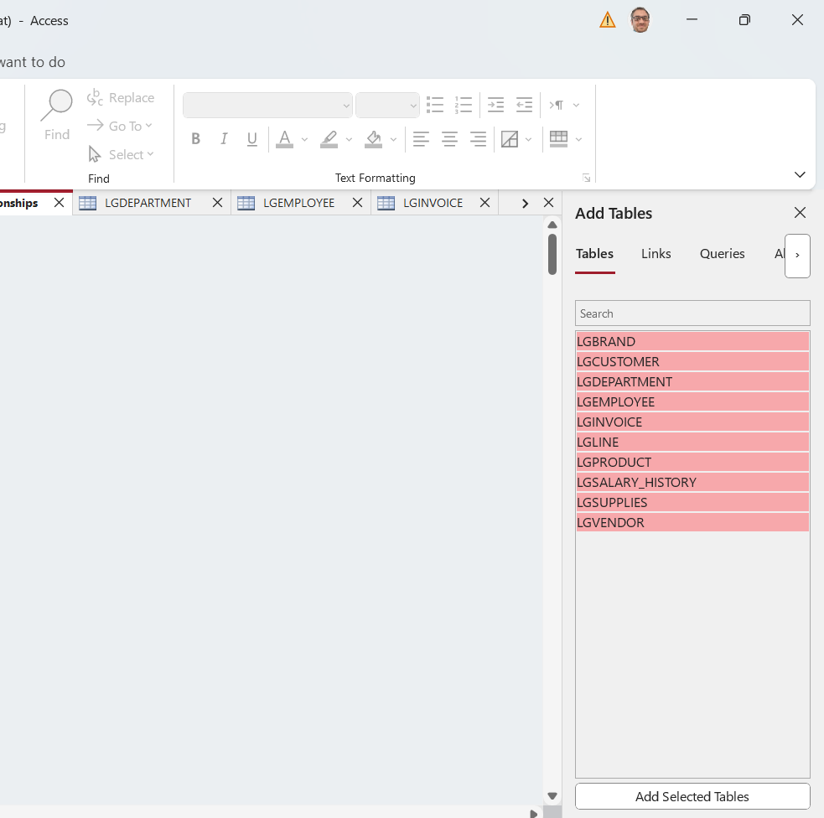
Part B – Independent Work on Assessment 3
Open Database Tools → Relationships → Hold Ctrl and Select All Tables → Add Selected Tables →

Slide 24
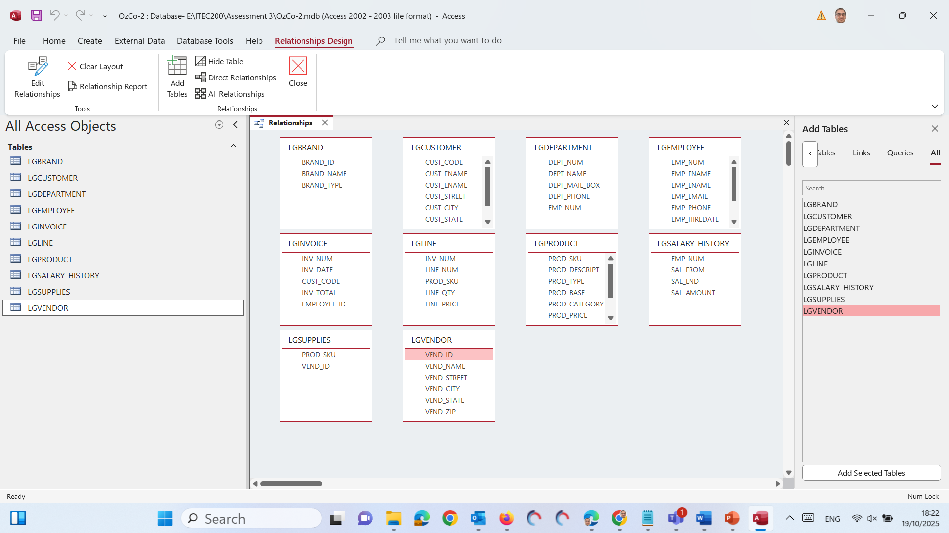
Part B – Independent Work on Assessment 3

Slide 25
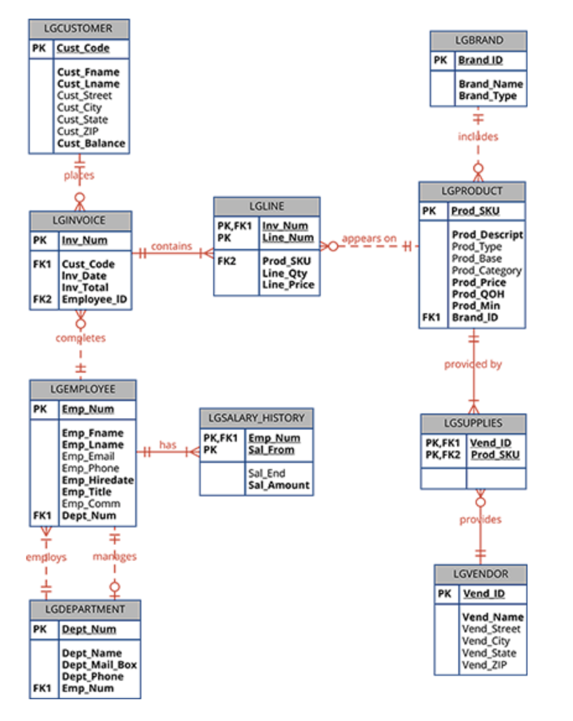
Part B – Independent Work on Assessment 3
Create manually
Table | Field | Related Table | Related Field
LGINVOICE | Cust_Code | LGCUSTOMER | Cust_Code
LGINVOICE | Employee_ID | LGEMPLOYEE | Emp_Num
LGLINE | Inv_Num | LGINVOICE | Inv_Num
LGLINE | Prod_SKU | LGPRODUCT | Prod_SKU
LGPRODUCT | Brand_ID | LGBRAND | Brand_ID
LGSUPPLIES | Vend_ID | LGVENDOR | Vend_ID
LGSUPPLIES | Prod_SKU | LGPRODUCT | Prod_SKU
LGEMPLOYEE | Dept_Num | LGDEPARTMENT | Dept_Num
LGSALARY_HISTORY | Emp_Num | LGEMPLOYEE | Emp_Num

Slide 26
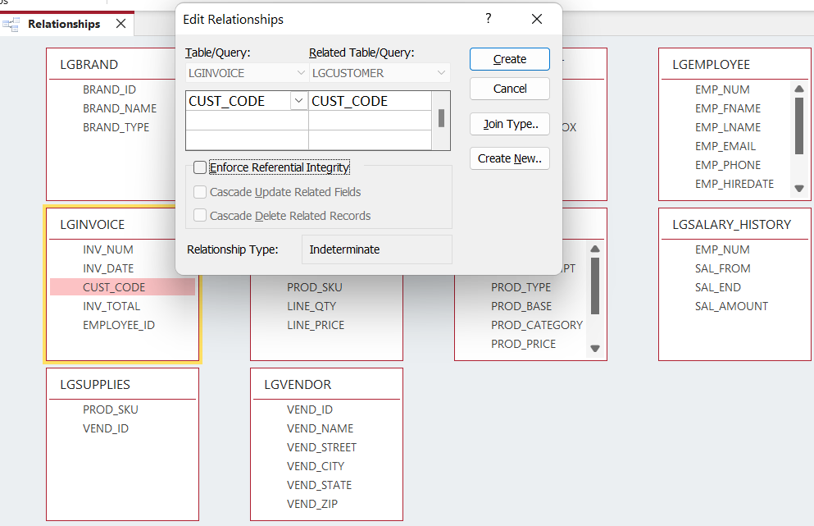
Part B – Independent Work on Assessment 3
Create manually
LGINVOICE ↔ LGCUSTOMER
Connect customers with their invoices.
From LGINVOICE, drag Cust_Code
Drop it onto Cust_Code in LGCUSTOMER

Slide 27
Part B – Independent Work on Assessment 3
Create manually
Table | Field | Related Table | Related Field
LGINVOICE | Cust_Code | LGCUSTOMER | Cust_Code
LGINVOICE | Employee_ID | LGEMPLOYEE | Emp_Num
LGLINE | Inv_Num | LGINVOICE | Inv_Num
LGLINE | Prod_SKU | LGPRODUCT | Prod_SKU
LGPRODUCT | Brand_ID | LGBRAND | Brand_ID
LGSUPPLIES | Vend_ID | LGVENDOR | Vend_ID
LGSUPPLIES | Prod_SKU | LGPRODUCT | Prod_SKU
LGEMPLOYEE | Dept_Num | LGDEPARTMENT | Dept_Num
LGSALARY_HISTORY | Emp_Num | LGEMPLOYEE | Emp_Num
Tick:
Enforce Referential Integrity
Cascade Update Related Fields (optional)
Click Create

Slide 28
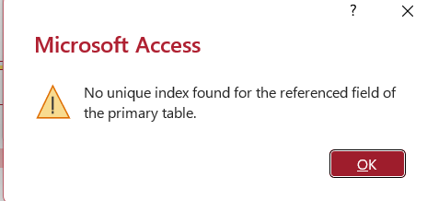
Part B – Independent Work on Assessment 3
When you enforce referential integrity, Access needs one side of the relationship to be a primary key or uniquely indexed field (so it can ensure every invoice belongs to a valid customer).

Slide 29
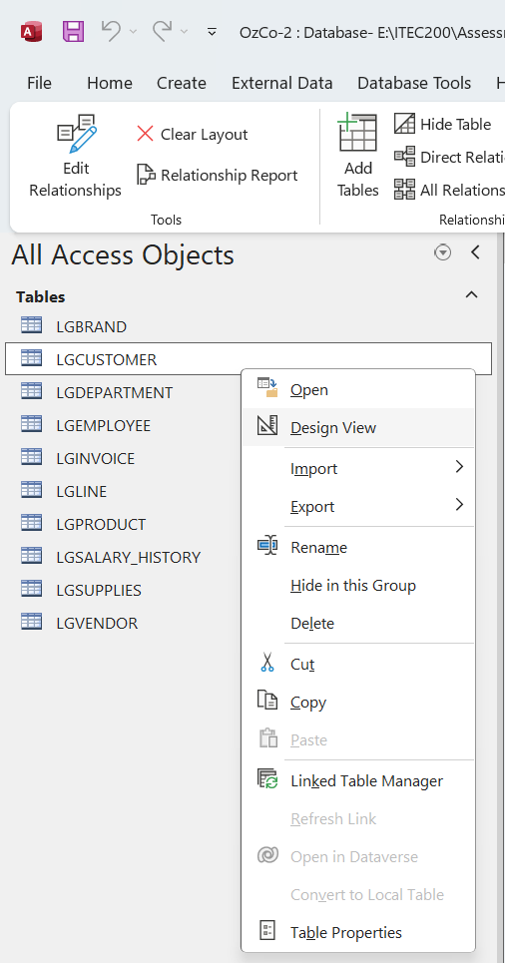
Part B – Independent Work on Assessment 3
Open LGCUSTOMER in Design View
Close the Relationships window first (click Close).
In the Navigation Pane (left side), right-click LGCUSTOMER → Design View.

Slide 30
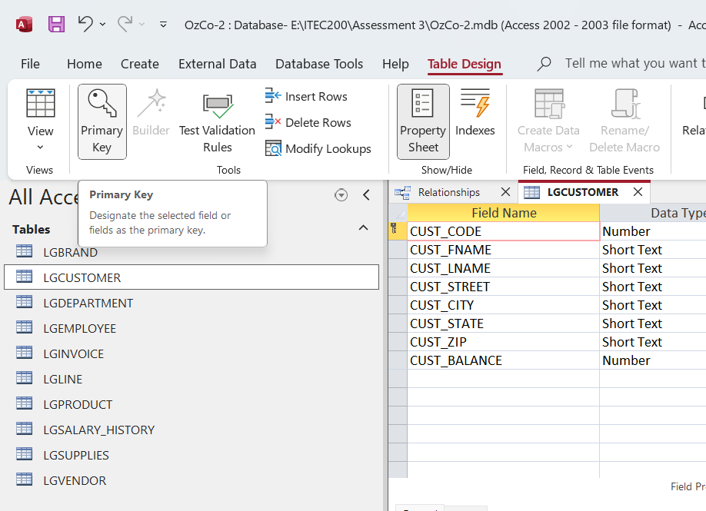
Part B – Independent Work on Assessment 3
Set the Primary Key
In the design view, click on the first row — Cust_Code.
On the top ribbon, click the Primary Key icon (under the Design tab).
You’ll now see a small key icon next to Cust_Code.
Press Ctrl+S to save the table.

Slide 31
Part B – Independent Work on Assessment 3
Repeat for Other Tables
While you’re here, check the other tables too — each one should have its key field set as follows:

Slide 32
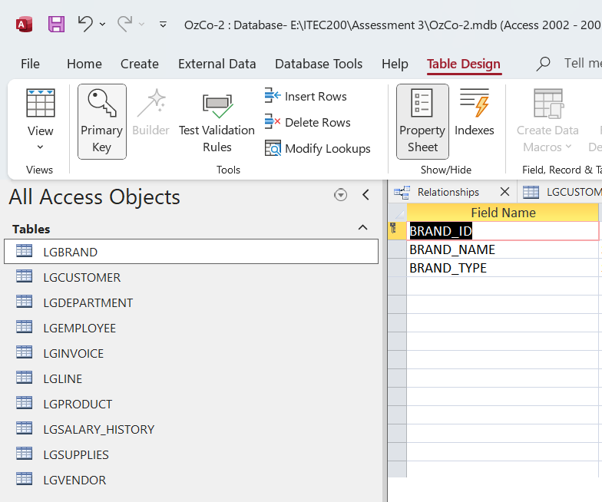
Part B – Independent Work on Assessment 3
Table | Primary Key Field
LGCUSTOMER | Cust_Code
LGBRAND | Brand_ID
LGDEPARTMENT | Dept_Num
LGEMPLOYEE | Emp_Num
LGINVOICE | Inv_Num
LGLINE | (Composite Key: Inv_Num + Line_Num)
LGPRODUCT | Prod_SKU
LGSALARY_HISTORY | (Composite Key: Emp_Num + Sal_From)
LGSUPPLIES | (Composite Key: Vend_ID + Prod_SKU)
LGVENDOR | Vend_ID

Slide 33
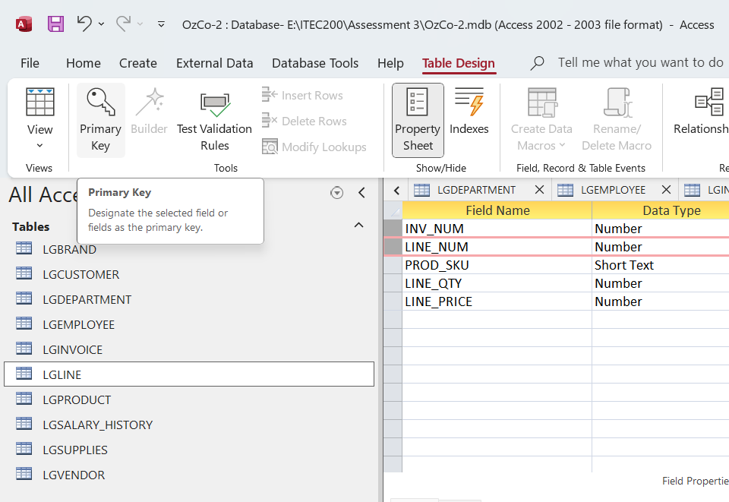
Part B – Independent Work on Assessment 3
Table | Primary Key Field
LGCUSTOMER | Cust_Code
LGBRAND | Brand_ID
LGDEPARTMENT | Dept_Num
LGEMPLOYEE | Emp_Num
LGINVOICE | Inv_Num
LGLINE | (Composite Key: Inv_Num + Line_Num)
LGPRODUCT | Prod_SKU
LGSALARY_HISTORY | (Composite Key: Emp_Num + Sal_From)
LGSUPPLIES | (Composite Key: Vend_ID + Prod_SKU)
LGVENDOR | Vend_ID
Select INV_NUM, hold down the Ctrl key on the keyboard.
While holding Ctrl, click the row selector for LINE_NUM.

Slide 34

Part B – Independent Work on Assessment 3
Table | Primary Key Field
LGCUSTOMER | Cust_Code
LGBRAND | Brand_ID
LGDEPARTMENT | Dept_Num
LGEMPLOYEE | Emp_Num
LGINVOICE | Inv_Num
LGLINE | (Composite Key: Inv_Num + Line_Num)
LGPRODUCT | Prod_SKU
LGSALARY_HISTORY | (Composite Key: Emp_Num + Sal_From)
LGSUPPLIES | (Composite Key: Vend_ID + Prod_SKU)
LGVENDOR | Vend_ID
Select Emp_Num, hold down the Ctrl key on the keyboard.
While holding Ctrl, click the row selector for Sal_From.

Slide 35

Part B – Independent Work on Assessment 3
Table | Primary Key Field
LGCUSTOMER | Cust_Code
LGBRAND | Brand_ID
LGDEPARTMENT | Dept_Num
LGEMPLOYEE | Emp_Num
LGINVOICE | Inv_Num
LGLINE | (Composite Key: Inv_Num + Line_Num)
LGPRODUCT | Prod_SKU
LGSALARY_HISTORY | (Composite Key: Emp_Num + Sal_From)
LGSUPPLIES | (Composite Key: Vend_ID + Prod_SKU)
LGVENDOR | Vend_ID
Select Vend_ID, hold down the Ctrl key on the keyboard.
While holding Ctrl, click the row selector for Prod_SKU.

Slide 36
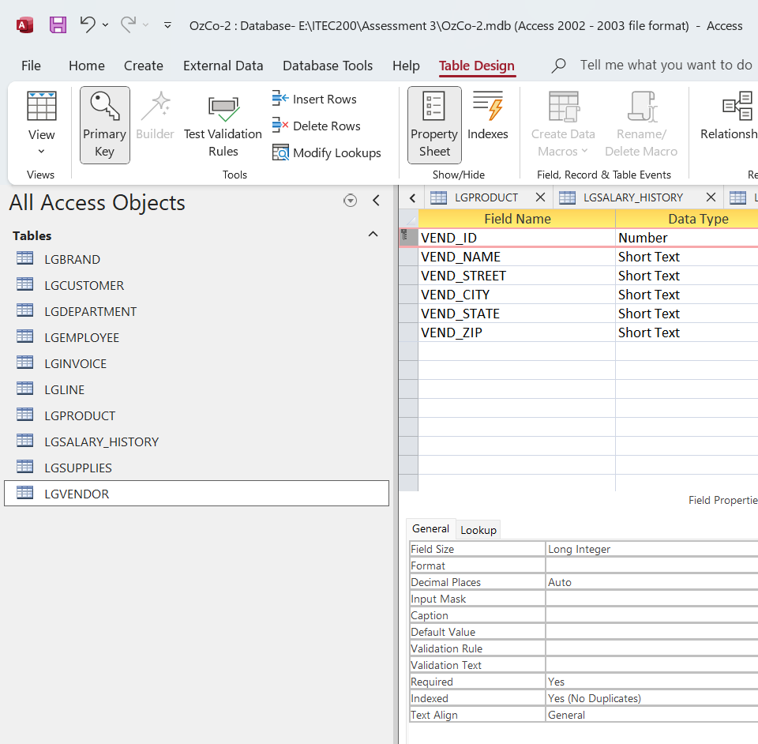
Part B – Independent Work on Assessment 3
Table | Primary Key Field
LGCUSTOMER | Cust_Code
LGBRAND | Brand_ID
LGDEPARTMENT | Dept_Num
LGEMPLOYEE | Emp_Num
LGINVOICE | Inv_Num
LGLINE | (Composite Key: Inv_Num + Line_Num)
LGPRODUCT | Prod_SKU
LGSALARY_HISTORY | (Composite Key: Emp_Num + Sal_From)
LGSUPPLIES | (Composite Key: Vend_ID + Prod_SKU)
LGVENDOR | Vend_ID
Once all finished, Ctrl + S to save it.

Slide 37
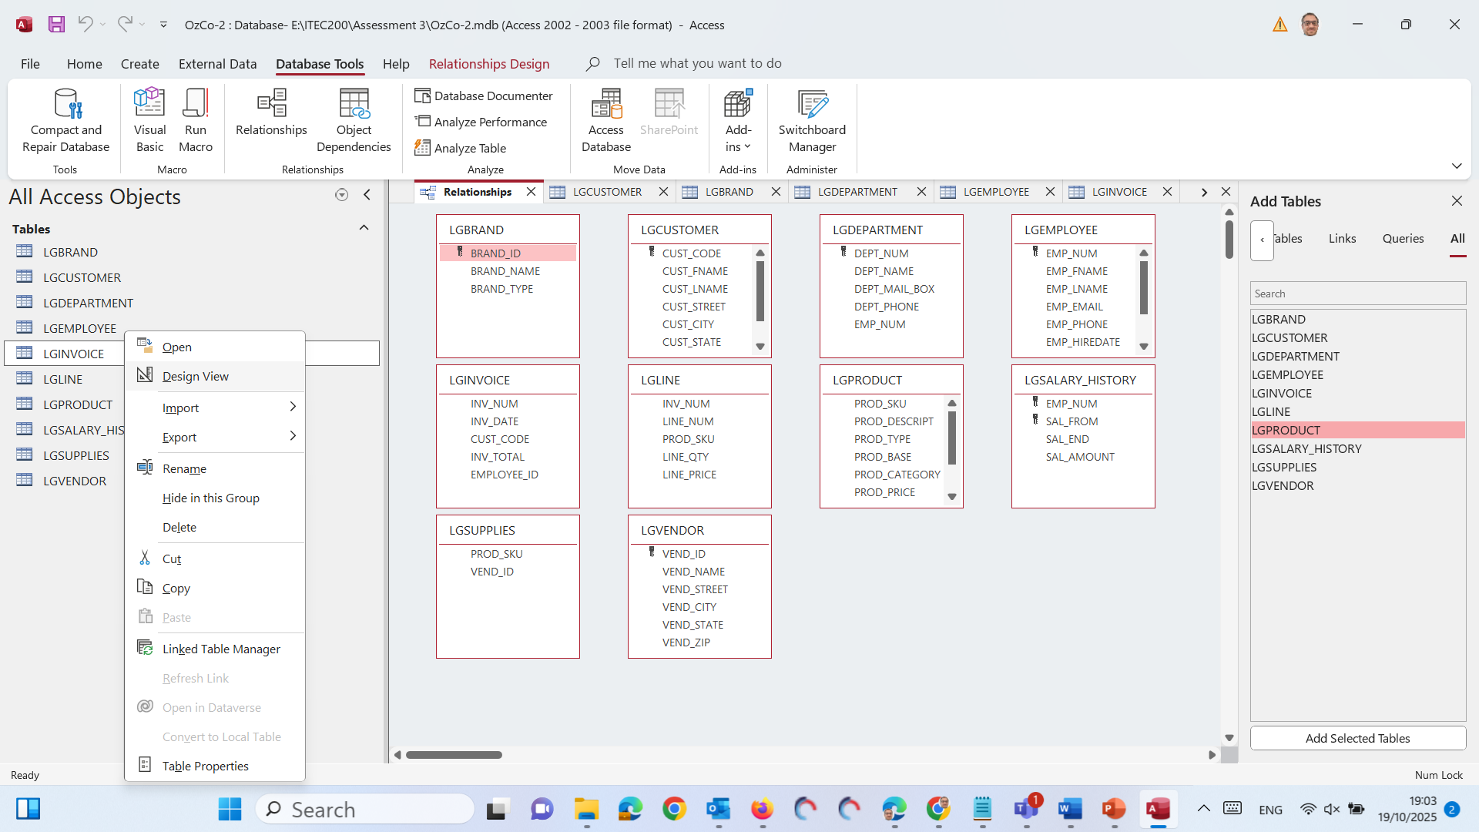
Part B – Independent Work on Assessment 3
Databased Tools → Relationships If you see the key is not showing, click design view on that table and Ctrl + S (to save the PK)

Slide 38
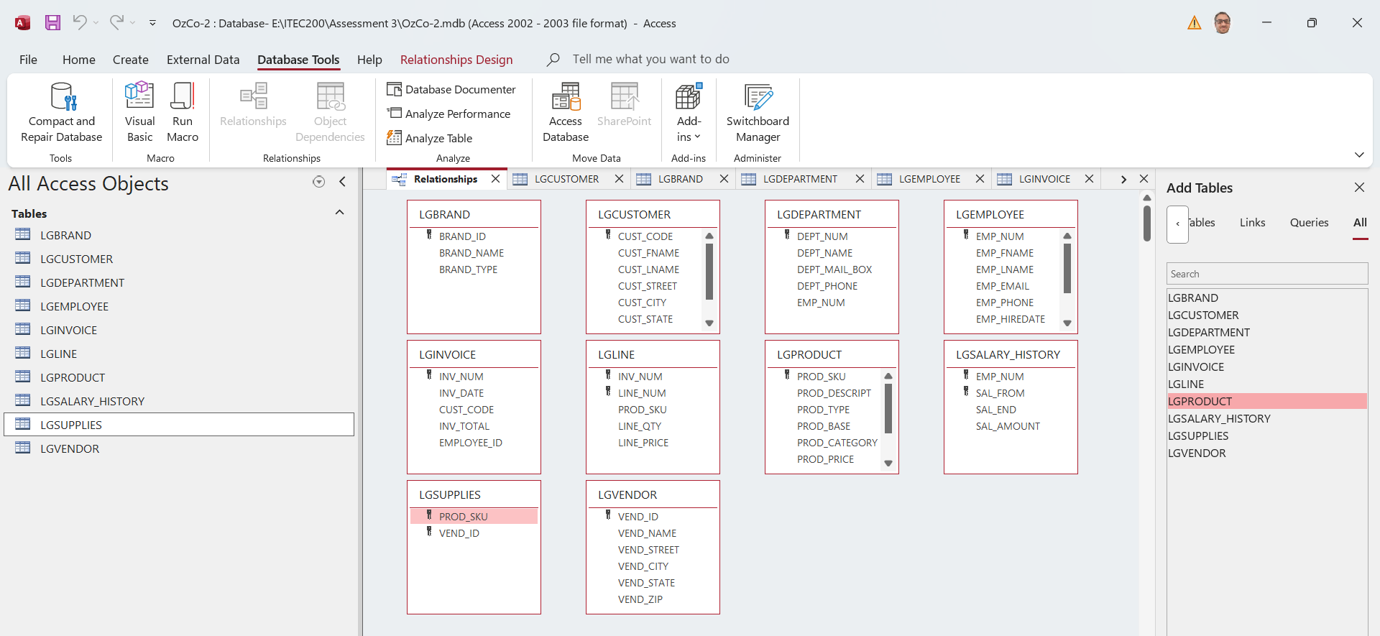
Part B – Independent Work on Assessment 3
Now we should see this

Slide 39
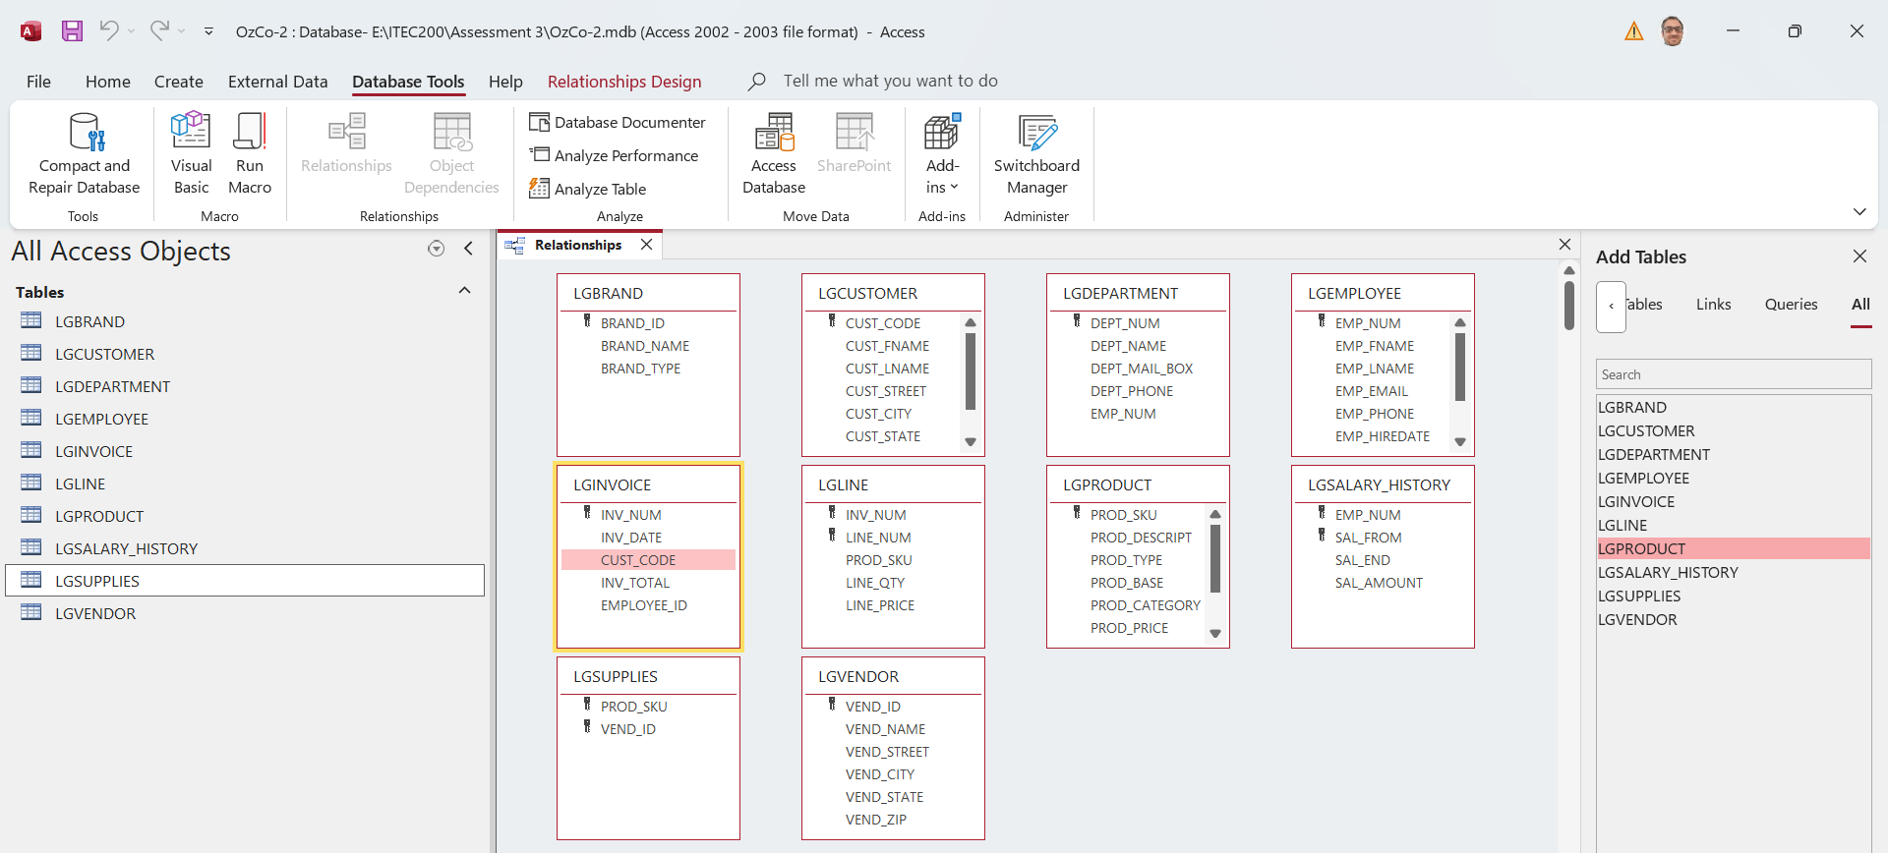
Part B – Independent Work on Assessment 3
Now that all Primary Keys (PKs) are set, we’re ready to rebuild all relationships cleanly and correctly.
Close All other windows (tables or windows), and see only Relationships Window and Take a screenshot with Time and Windo of your computer/laptop at the bottom

Slide 40
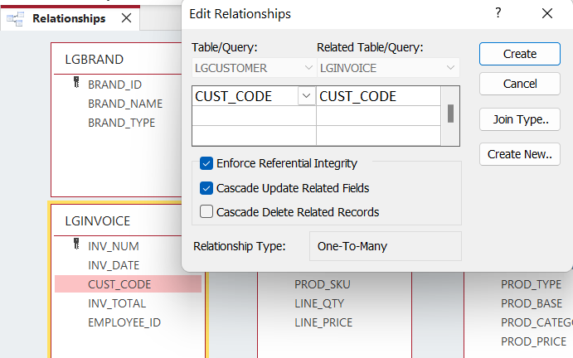
Part B – Independent Work on Assessment 3
LGINVOICE ↔ LGCUSTOMER
Purpose: Each invoice belongs to one customer.
Drag: LGINVOICE.Cust_Code → LGCUSTOMER.Cust_Code
Tick:
Enforce Referential Integrity
Cascade Update Related Fields (optional)
Click Create

Slide 41
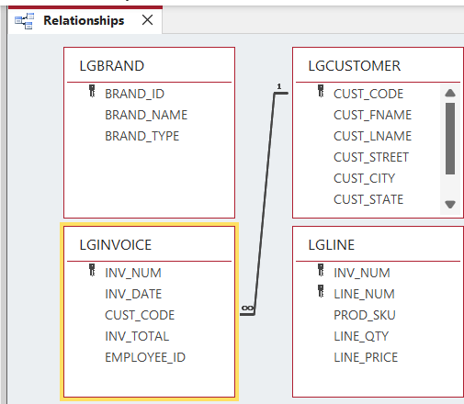
Part B – Independent Work on Assessment 3
LGINVOICE ↔ LGCUSTOMER
Purpose: Each invoice belongs to one customer.
Drag: LGINVOICE.Cust_Code → LGCUSTOMER.Cust_Code
Tick:
Enforce Referential Integrity
Cascade Update Related Fields (optional)
Click Create

Slide 42
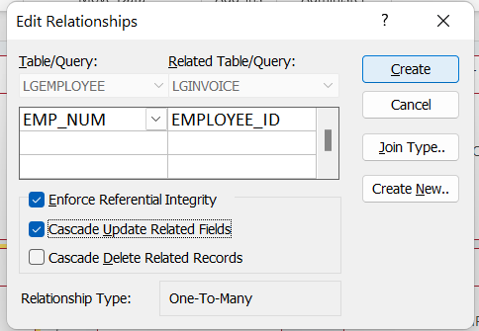
Part B – Independent Work on Assessment 3
LGINVOICE ↔ LGEMPLOYEE
Purpose: Each invoice is issued by one employee.
Drag: LGINVOICE.Employee_ID → LGEMPLOYEE.Emp_Num
Tick:
Enforce Referential Integrity
Cascade Update Related Fields
Click Create

Slide 43
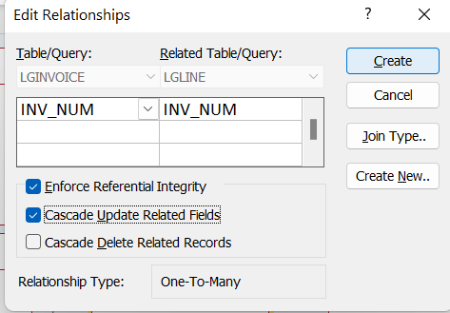
Part B – Independent Work on Assessment 3
LGLINE ↔ LGINVOICE
Purpose: Each line item belongs to one invoice.
Drag: LGLINE.Inv_Num → LGINVOICE.Inv_Num
Tick:
Enforce Referential Integrity
Cascade Update Related Fields
Click Create

Slide 44
Part B – Independent Work on Assessment 3
LGLINE ↔ LGPRODUCT
Purpose: Each line item refers to one product.
Drag: LGPRODUCT.Prod_SKU → LGLINE.Prod_SKU
Tick:
Enforce Referential Integrity
Cascade Update Related Fields
Click Create

Slide 45
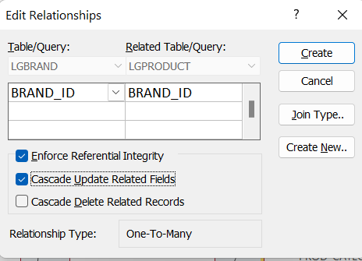
Part B – Independent Work on Assessment 3
LGPRODUCT ↔ LGBRAND
Purpose: Each product belongs to one brand.
Drag: LGPRODUCT.Brand_ID → LGBRAND.Brand_ID
Tick:
Enforce Referential Integrity
Cascade Update Related Fields
Click Create

Slide 46
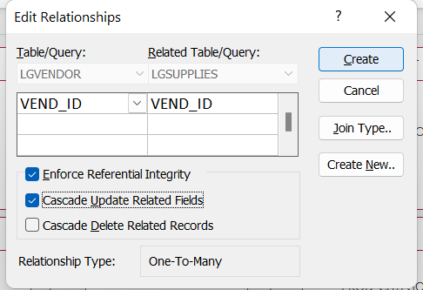
Part B – Independent Work on Assessment 3
LGSUPPLIES ↔ LGVENDOR
Purpose: Each record shows which vendor supplies a product.
Drag: LGSUPPLIES.Vend_ID → LGVENDOR.Vend_ID
Tick:
Enforce Referential Integrity
Cascade Update Related Fields
Click Create

Slide 47
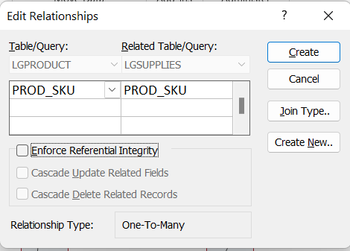
Part B – Independent Work on Assessment 3
LGSUPPLIES ↔ LGPRODUCT
Purpose: Each record also links to the product being supplied.
Drag: LGSUPPLIES.Prod_SKU → LGPRODUCT.Prod_SKU
Tick:
Enforce Referential Integrity
Cascade Update Related Fields
Click Create

Slide 48
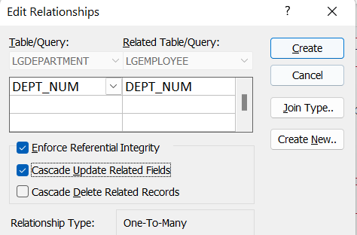
Part B – Independent Work on Assessment 3
LGEMPLOYEE ↔ LGDEPARTMENT
Purpose: Each employee works in one department.
Drag: LGEMPLOYEE.Dept_Num → LGDEPARTMENT.Dept_Num
Tick:
Enforce Referential Integrity
Cascade Update Related Fields
Click Create

Slide 49
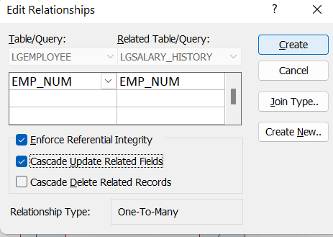
Part B – Independent Work on Assessment 3
LGSALARY_HISTORY ↔ LGEMPLOYEE
Purpose: Each salary record belongs to one employee.
Drag: LGSALARY_HISTORY.Emp_Num → LGEMPLOYEE.Emp_Num
Tick:
Enforce Referential Integrity
Cascade Update Related Fields
Click Create

Slide 50
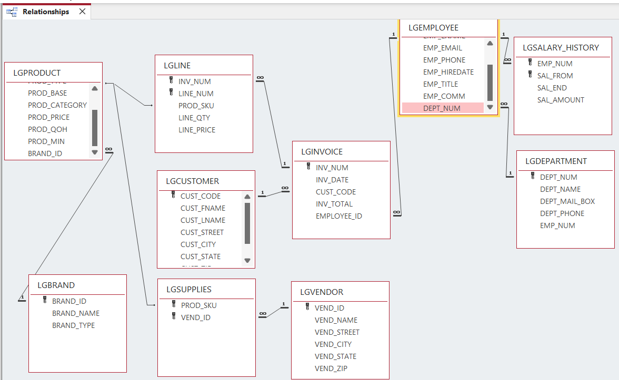
Part B – Independent Work on Assessment 3
Save and Verify
Click Save Layout (Ctrl+S).
You should now see all relationship lines with 1–∞ symbols.
Close the window.

Slide 51
Part B – Independent Work on Assessment 3
Visual Check Summary
Relationship | From Table | Field | To Table | Field | Type
1 | LGINVOICE | Cust_Code | LGCUSTOMER | Cust_Code | 1–∞
2 | LGINVOICE | Employee_ID | LGEMPLOYEE | Emp_Num | 1–∞
3 | LGLINE | Inv_Num | LGINVOICE | Inv_Num | 1–∞
4 | LGLINE | Prod_SKU | LGPRODUCT | Prod_SKU | 1–∞
5 | LGPRODUCT | Brand_ID | LGBRAND | Brand_ID | 1–∞
6 | LGSUPPLIES | Vend_ID | LGVENDOR | Vend_ID | 1–∞
7 | LGSUPPLIES | Prod_SKU | LGPRODUCT | Prod_SKU | 1–∞
8 | LGEMPLOYEE | Dept_Num | LGDEPARTMENT | Dept_Num | 1–∞
9 | LGSALARY_HISTORY | Emp_Num | LGEMPLOYEE | Emp_Num | 1–∞

Slide 52
Part B – Independent Work on Assessment 3
Step 4: Create queries
Go to Create → Query Design or SQL View.
Clarification: Query Design is easier for beginners. SQL View is faster if you know the code.
Query name must match the question number (e.g., Query 1, Query 2, …, Query 15)

Slide 53
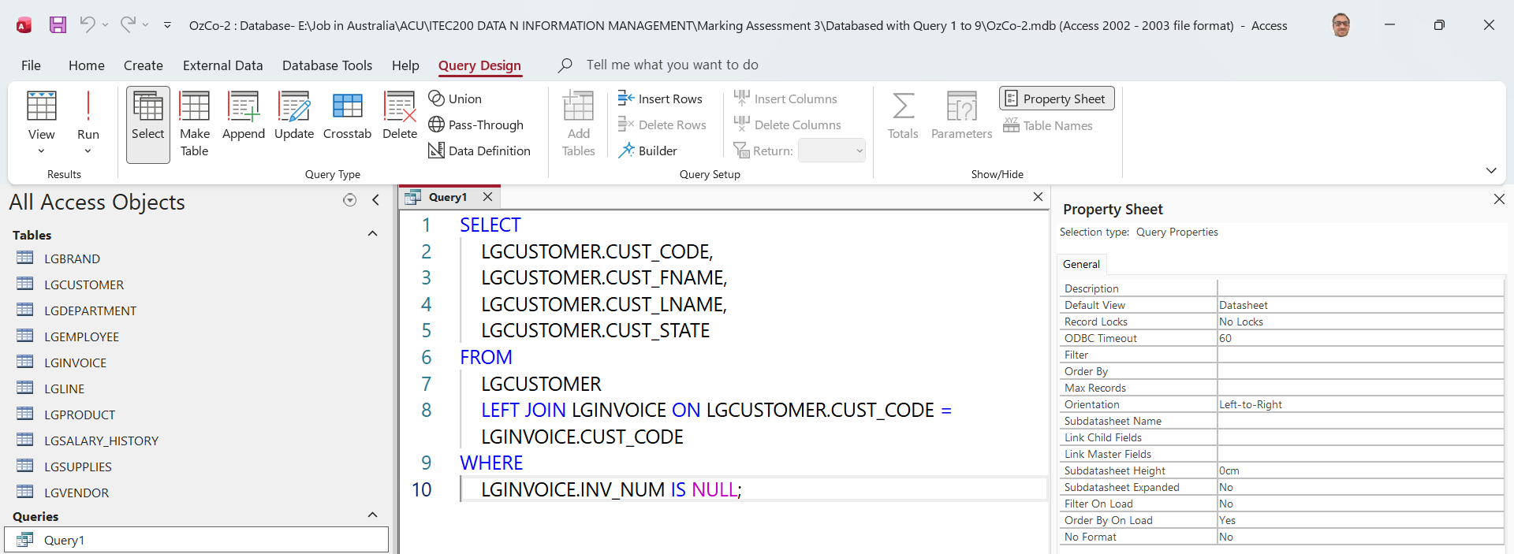
Part B – Independent Work on Assessment 3
Let’s do Query 1 to 5 together - Query 1) Find customers who have not placed any invoices.
Clarification: This uses a LEFT JOIN to show customers even if they have no invoice. The IS NULL part finds customers with no matching invoice.

Slide 54
Part B – Independent Work on Assessment 3
This chooses the customer code, first name, last name, and state.
FROM LGCUSTOMER LEFT JOIN LGINVOICE ON LGCUSTOMER.CUST_CODE = LGINVOICE.CUST_CODE
This connects customers to invoices.

Slide 55
Part B – Independent Work on Assessment 3
LEFT JOIN keeps all customers, even customers with no invoice.
WHERE LGINVOICE.INV_NUM IS NULL;
This finds customers where no invoice exists.

Slide 56
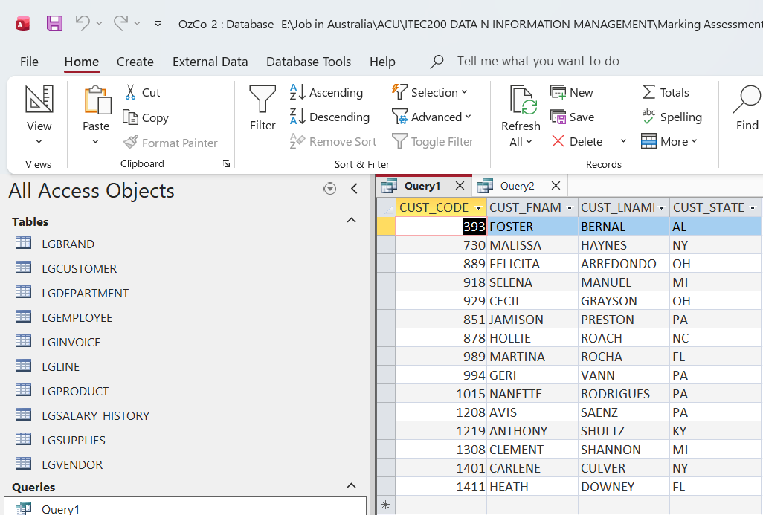
Part B – Independent Work on Assessment 3
Query 1) Find customers who have not placed any invoices.

Slide 57
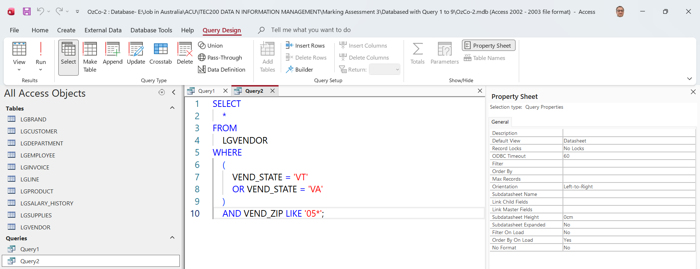
Part B – Independent Work on Assessment 3
Query 2) Find all vendors located in VT or VA whose ZIP code starts with 05.
Clarification: LIKE '05*' means the ZIP code begins with 05.

Slide 58
Part B – Independent Work on Assessment 3
Query 2
SELECT * FROM LGVENDOR
This shows all columns from the vendor table.
WHERE (VEND_STATE = 'VT' OR VEND_STATE = 'VA')
This finds vendors in Vermont or Virginia.
AND VEND_ZIP LIKE '05*';
This only keeps vendors whose ZIP code starts with 05.

Slide 59
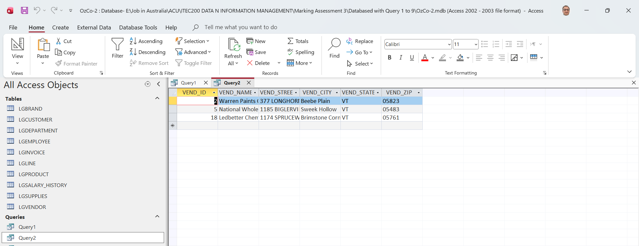
Part B – Independent Work on Assessment 3

Slide 60
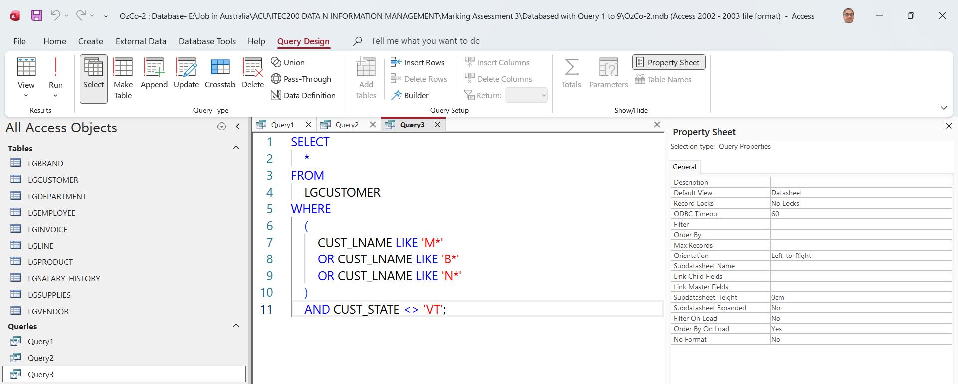
Part B – Independent Work on Assessment 3
Query 3) Display customers whose last name starts with M, B, or N and who live outside VT.
Clarification: <> 'VT' means “not equal to VT”.

Slide 61
Part B – Independent Work on Assessment 3
Query 3
SELECT * FROM LGCUSTOMER
This shows all customer details.
WHERE (CUST_LNAME LIKE 'M*' OR CUST_LNAME LIKE 'B*' OR CUST_LNAME LIKE 'N*')
This finds last names starting with M, B, or N.

Slide 62
Part B – Independent Work on Assessment 3
AND CUST_STATE <> 'VT';
This removes customers who live in VT.

Slide 63
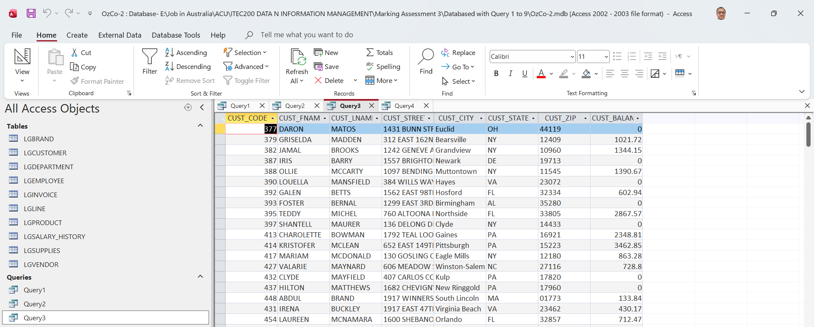
Part B – Independent Work on Assessment 3

Slide 64
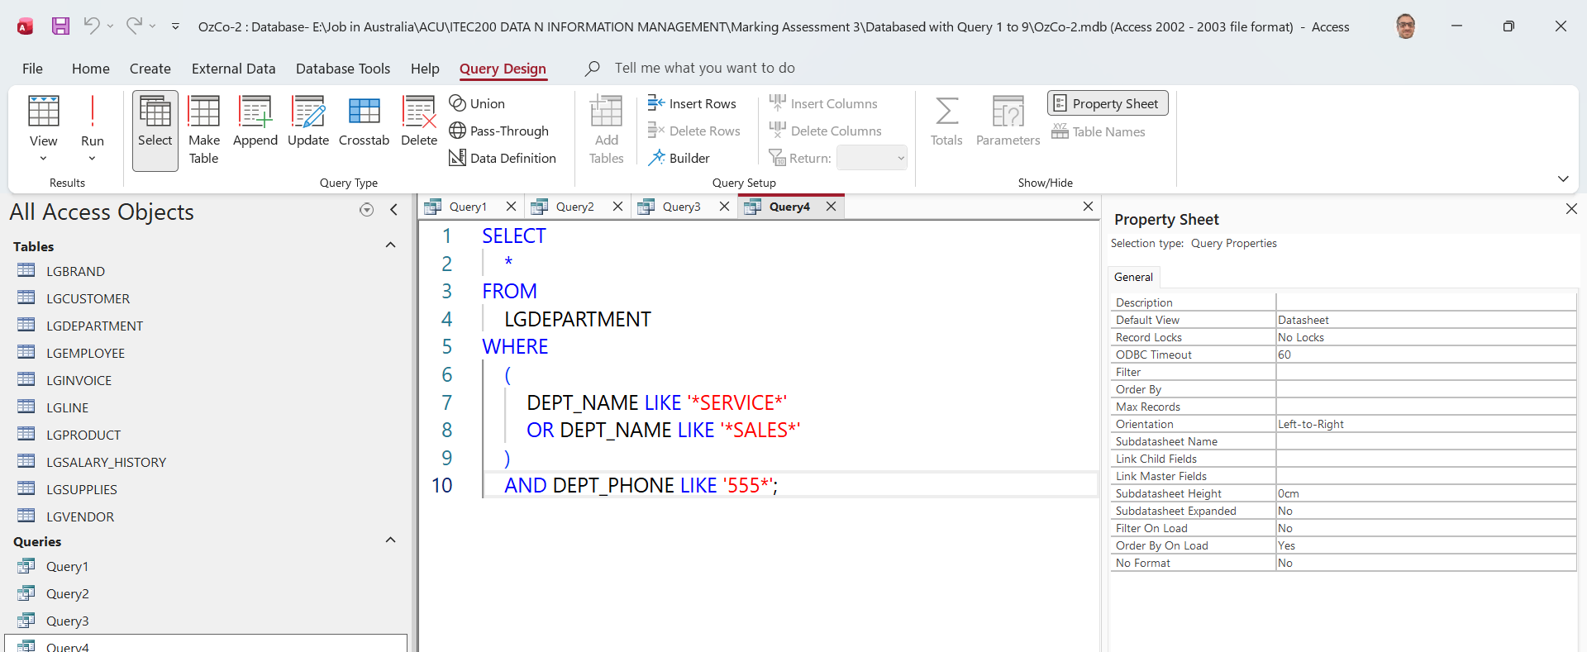
Part B – Independent Work on Assessment 3
Query 4) Show departments whose name contains SERVICE or SALES and phone number starts with 555.
Clarification: *SERVICE* means the word SERVICE can appear anywhere in the department name.

Slide 65
Part B – Independent Work on Assessment 3
Query 4
SELECT * FROM LGDEPARTMENT
This shows all department details.
WHERE (DEPT_NAME LIKE '*SERVICE*' OR DEPT_NAME LIKE '*SALES*')
This finds department names containing SERVICE or SALES.

Slide 66
Part B – Independent Work on Assessment 3
AND DEPT_PHONE LIKE '555*';
This only keeps departments whose phone number starts with 555.

Slide 67
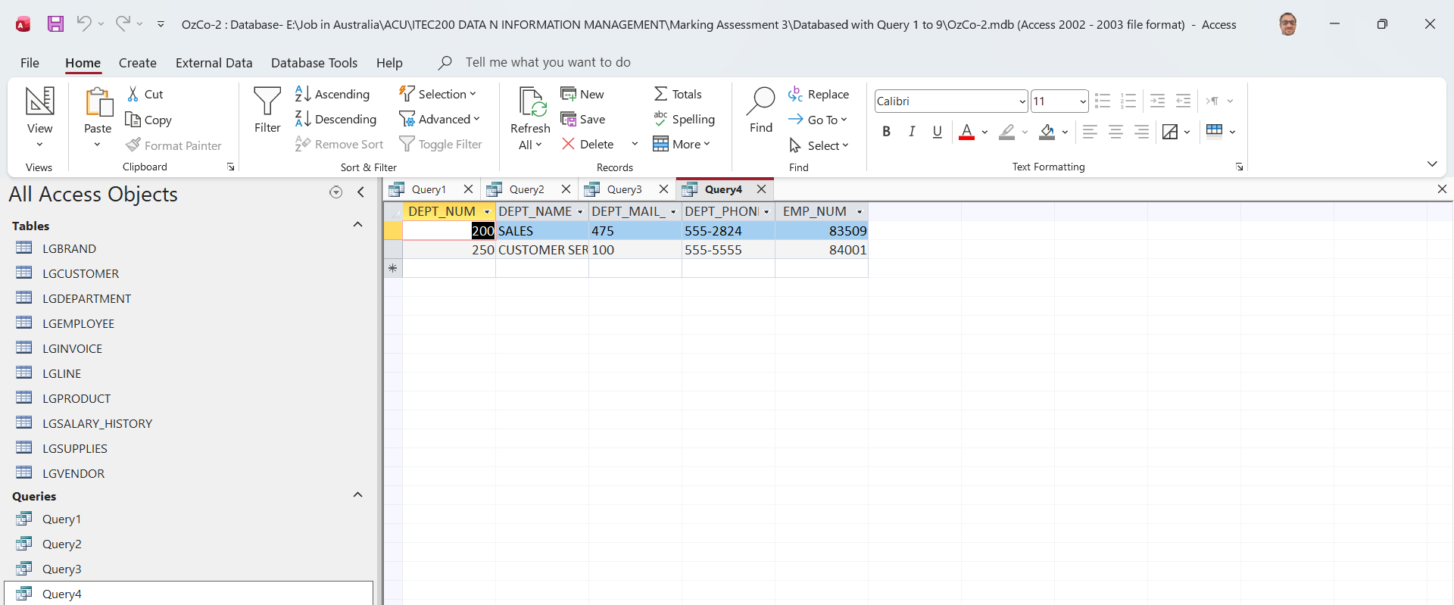
Part B – Independent Work on Assessment 3

Slide 68
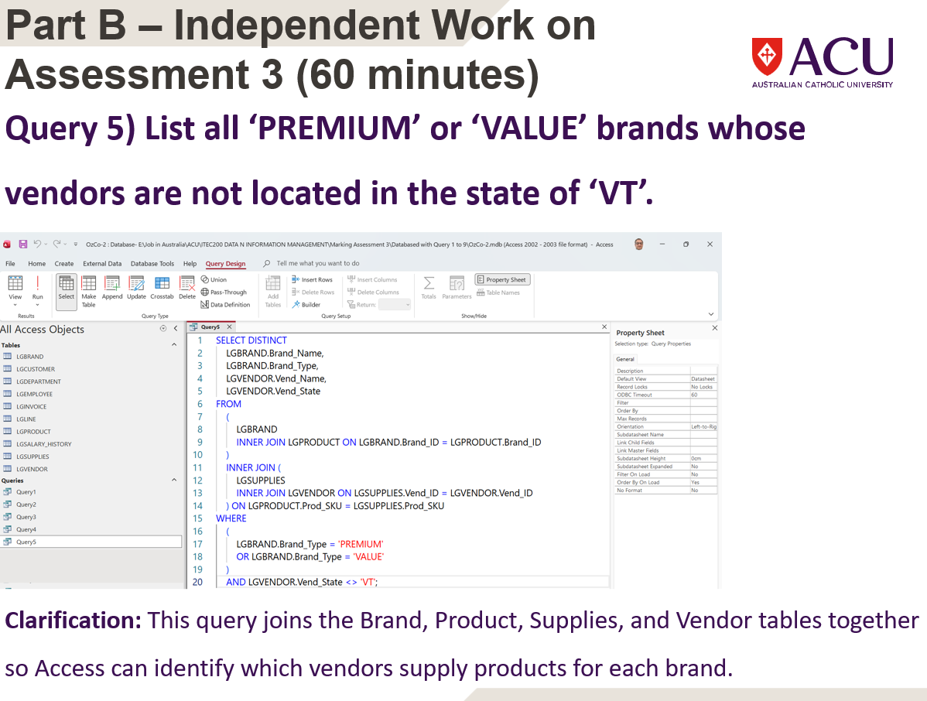
Part B – Independent Work on Assessment 3

Slide 69
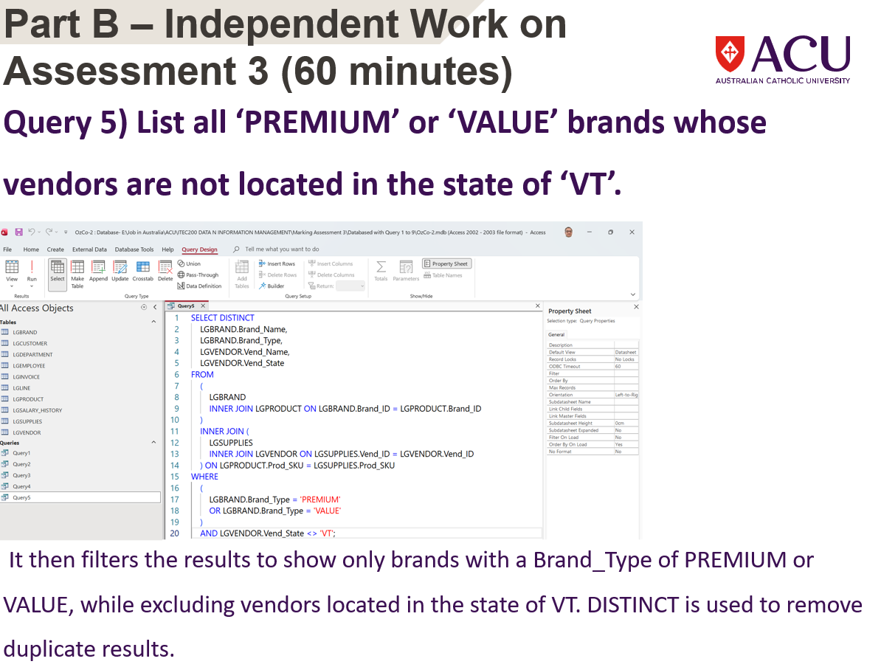
Part B – Independent Work on Assessment 3

Slide 70
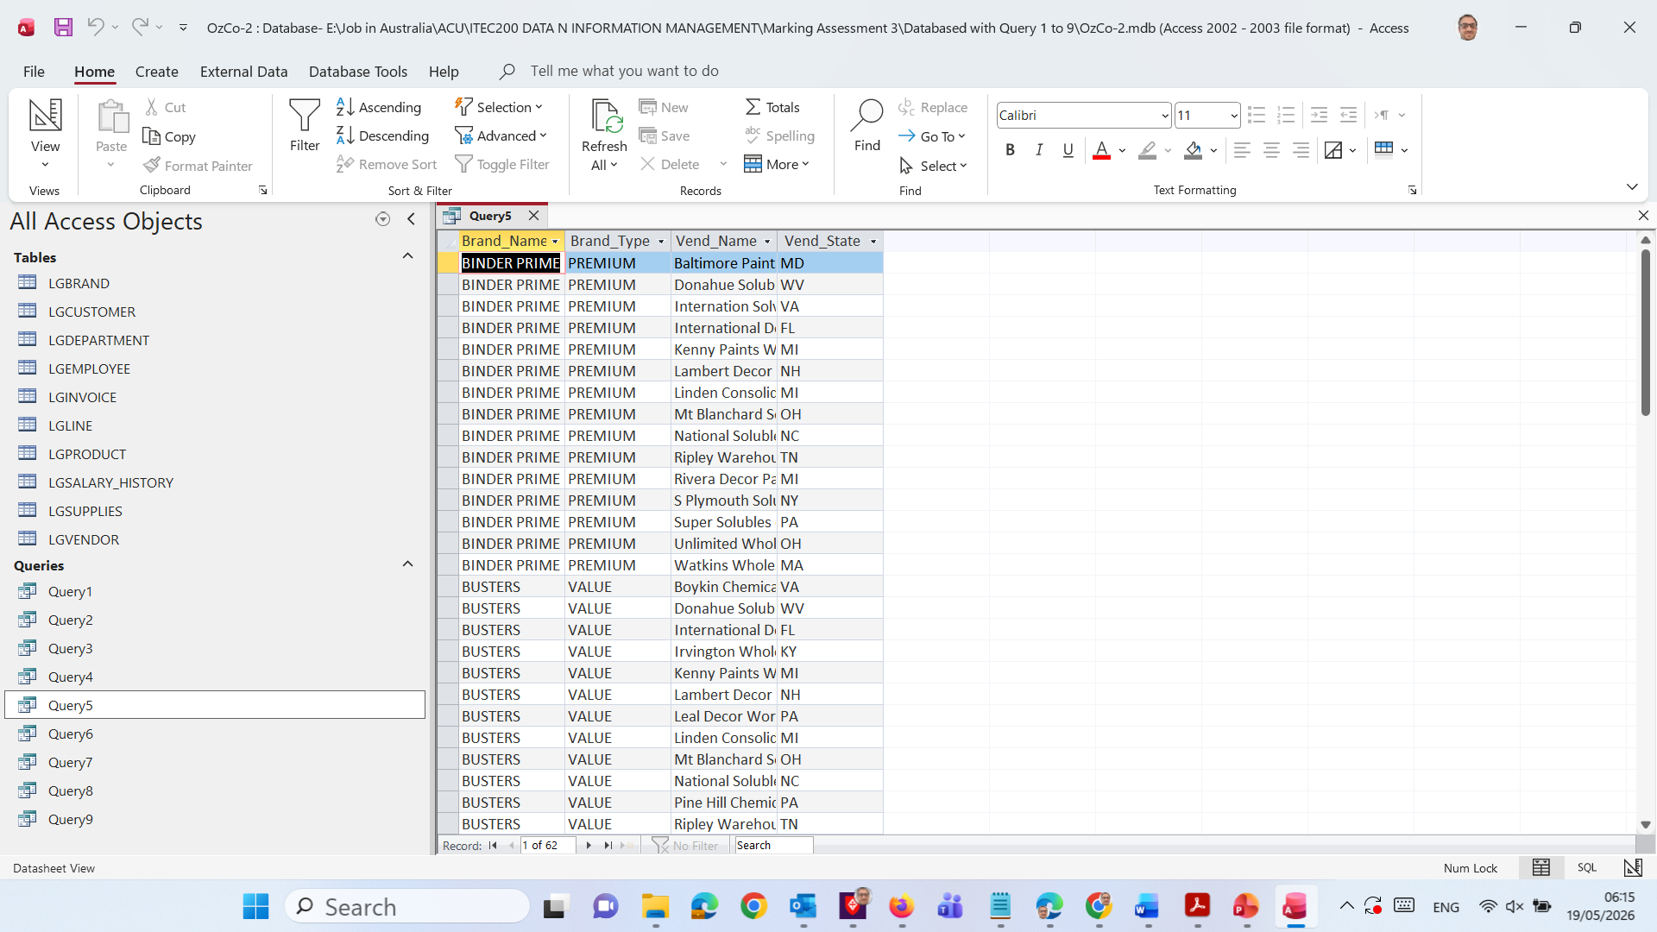
Part B – Independent Work on Assessment 3
It joins Brand → Product → Supplies → Vendor, then keeps only PREMIUM or VALUE brands where the vendor is not in VT.

Slide 71

Thank You
Happy Learning and Bright Futures Ahead! Dr. Farshid Keivanian Stay Connected: linkedin.com/in/farshid-keivanian github.com/FarshidKeivanian
Education is the most powerful weapon you can use to change the world. — Nelson Mandela

